Slide 1


an integrated atlas for exploration and analysis of network medicine data

Slide 2
Goal of the project
To create an human genetic atlas aggregating different data sources
To explore dinamically the atlas and retrieve informations
To analyse stored data and show statistics

Slide 3
Datasets
Gene-gene interactions:
Biogrid (entrez), 697804 tuples
IntAct (uniprot), 1118895 tuples
Mint (uniprot), 57190 tuples
Dip (uniprot), 7705 tuples
Matrixdb (uniprot), 1661 tuples
Innate (ensembl), 24077 tuples
Drug-gene interactions:
Biogrid
DGI
(no identificators)
Disease-gene interactions:
DisGeNET (disease id)
Biosnap (disease id)

Slide 4
NeTlas architecture
GENES DRUGS DISEASES
Biogrid
Intact
Mint
Biogrid
DisGe
NET
Dip
Matrixdb
Innate
DGI
BioSnap
DATA QUALITY
PARSING OF DATA

Slide 5
NeTlas architecture
Biogrid
Intact
Mint
Biogrid
DisGe
NET
Dip
Matrixdb
Innate
DGI
BioSnap
DATA AGGREGATION
GENES
DRUGS
DISEASES
RELIABILITY SCORE

Slide 6
NeTlas architecture
Biogrid
Intact
Mint
Biogrid
DisGe
NET
DRUGS
Dip
Matrixdb
Innate
DGI
BioSnap
GENES
DISEASES
NEO4J
GRAPHICAL VISUALIZATION
(node.js/cytoscape.js)

Slide 7
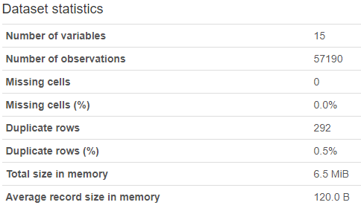
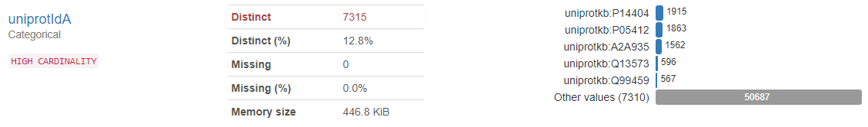
Data quality
Pandas-profiling:
Pandas-profiling extends the pandas DataFrame for quick data analysis.
For each column various statistics - if relevant for the column type - are presented in an interactive HTML report:

Slide 8
Parsing of data
Various actions like:
Grouping tuples with same ids
Standardizing data
Deleting useless tuples
Adding useful columns
Saving the output
New gene datasets:
Biogrid: 697804 → 484711 tuples
IntAct: 1118895 → 287529 tuples
Mint: 57190 → 26656 tuples
Innate: 24077 → 10317 tuples
Dip: 7705 → 5006 tuples
Matrixdb: 1661 → 229 tuples

Slide 9
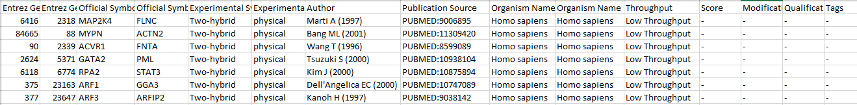
Parsing of data
BIOGRID
Delete meaningless or useless columns
Unify tuples with the same pair (Entrez Gene Id A , Entrez Gene Id B)
Split different data in the same record with format a|b|c|d
Delete rows without Entrez Gene Id A or Entrez Gene Id B
Delete rows not referring to human genes
Adding columns related to Uniprot Ids, Ensembl Ids mapped from uniprot-entrez-ensembl-hgnc.xlsx

Slide 10
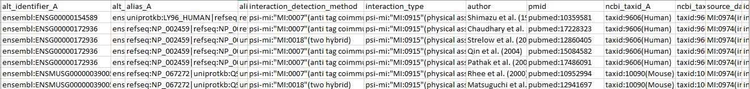
Parsing of data
INNATEDB
Delete meaningless or useless columns
Delete labels from ids columns
Unify tuples with the same pair (alt_identifier_A , alt_identifier_B)
Delete labels from the other columns and split different data in the same record with format a|b|c|d
Delete rows without alt_identifier_A or alt_identifier_B
Delete rows not referring to human genes
Adding columns related to Uniprot Ids, Entrez Ids mapped from uniprot-entrez-ensembl-hgnc.xlsx

Slide 11
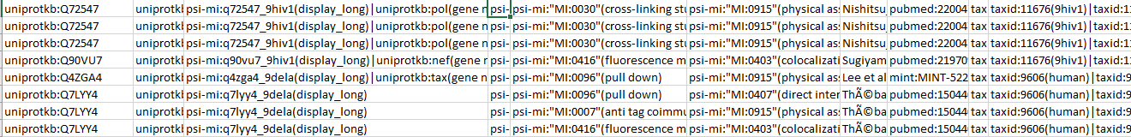
Parsing of data
MINT
Delete meaningless or useless columns
Delete labels from ids columns
Unify tuples with the same pair (uniprotid_A , uniprotid_B)
Delete labels from the other columns and split different data in the same record with format a|b|c|d
Delete rows without uniprotid_A or uniprotid_B
Delete rows not referring to human genes
Adding columns related to Ensembl Ids, Entrez Ids mapped from uniprot-entrez-ensembl-hgnc.xlsx

Slide 12
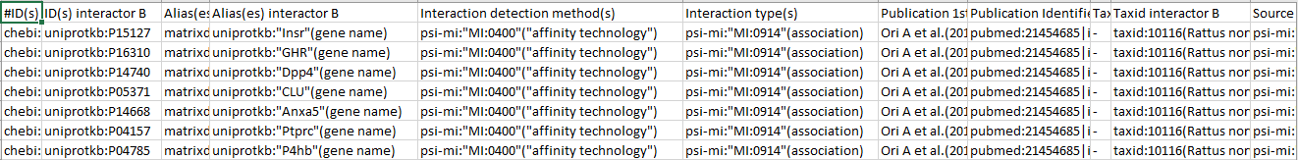
Parsing of data
MATRIXDB
Delete meaningless or useless columns
Delete labels from ids columns
Unify tuples with the same pair (uniprotid_A , uniprotid_B)
Delete labels from the other columns and split different data in the same record with format a|b|c|d
Delete rows without uniprotid_A or uniprotid_B
Delete rows not referring to human genes
Adding columns related to Ensembl Ids, Entrez Ids mapped from uniprot-entrez-ensembl-hgnc.xlsx

Slide 13
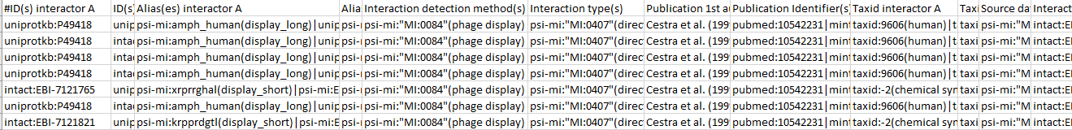
Parsing of data
INTACT
Delete meaningless or useless columns
Delete labels from ids columns
Unify tuples with the same pair (uniprotid_A , uniprotid_B)
Delete labels from the other columns and split different data in the same record with format a|b|c|d
Delete rows without uniprotid_A or uniprotid_B
Delete rows not referring to human genes
Adding columns related to Ensembl Ids, Entrez Ids mapped from uniprot-entrez-ensembl-hgnc.xlsx

Slide 14
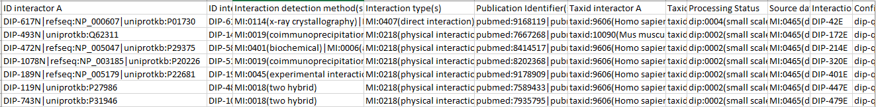
Parsing of data
DIP
Delete meaningless or useless columns
Delete labels from all the columns
Delete rows without ID interactor A or ID interactor B
Delete rows not referring to human genes
Adding columns related to Ensembl Ids, Entrez Ids mapped from uniprot-entrez-ensembl-hgnc.xlsx

Slide 15
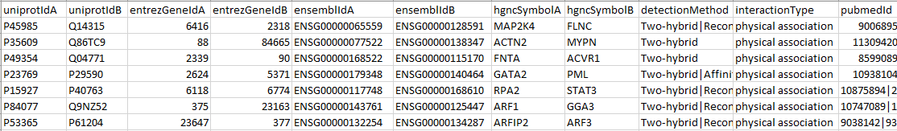
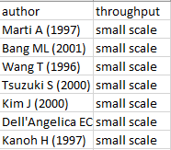
Parsing of data
RESULT
All the datasets
Dip
Biogrid
Innatedb
Intact
Matrixdb
Mint
Biogrid

Slide 16
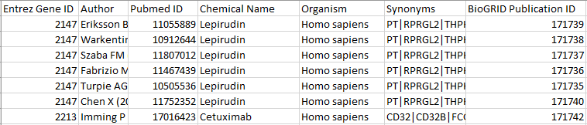
Parsing of data
BIOGRID
Delete meaningless or useless columns
Delete rows without Chemical name
Delete rows not referring to human genes
Unify tuples with the same Chemical name
Split different data in the same record with format a|b|c|d

Slide 17
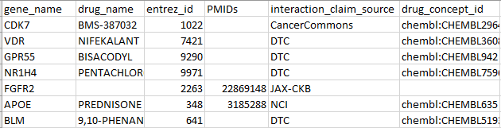
Parsing of data
DGI
Delete meaningless or useless columns
Delete rows without drug_name
Unify tuples with the same drug_name
Split different data in the same record with format a|b|c|d

Slide 18
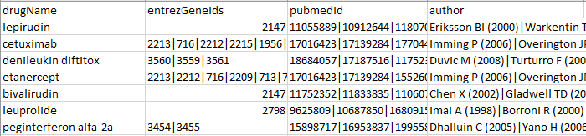
Parsing of data
RESULT
All the datasets
Biogrid

Slide 19
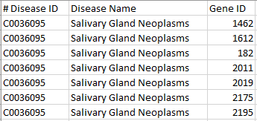
Parsing of data
BIOSNAP
Unify tuples with the same Disease ID
Split different data in the same record with format a|b|c|d

Slide 20
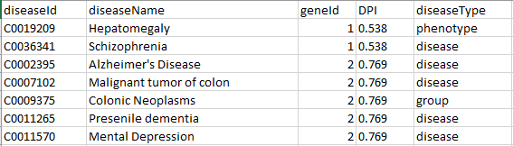
Parsing of data
DISGENET
Delete meaningless or useless columns
Unify tuples with the same diseaseId
Split different data in the same record with format a|b|c|d

Slide 21
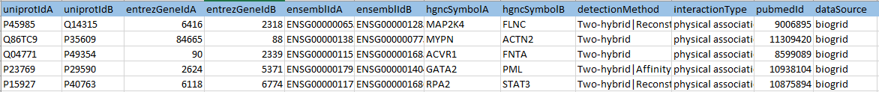
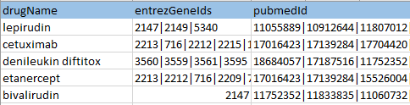
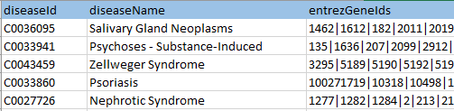
Data aggregation
Genes (tuples 610616):
Drugs (24398 tuples):
Diseases (9543 tuples):

Slide 22
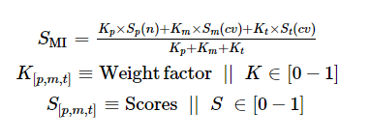
Reliability score
Miscore: number of publications:
number of publications (p)
experimental detection methods (m)
interaction types (t)
 | MEAN | MAX | 1 | 2 | 3 | 4 | >4
BIOGRID | 1,21 | 424 | 88,35% | 8,44% | 1,62% | 0,62% | 0,96%
DIP | 1,19 | 21 | 88,37% | 7,9% | 2,18% | 0,86% | 0,7%
MATRIX | 1,06 | 4 | 95,2% | 4,7% | 0% | 0,44% | 0%
MINT | 1,05 | 18 | 96,87% | 2,37% | 0,47% | 0,15% | 0,15%
INNATE | 1,18 | 24 | 91,48% | 5,16% | 1,45% | 0,7% | 1,21%
INTACT | 1,10 | 49 | 93,68% | 4,43% | 1,12% | 0,39% | 0,38%
GENES | 1,19 | 438 | 89,49% | 7,52% | 1,54% | 0,57% | 0,88%

Slide 23
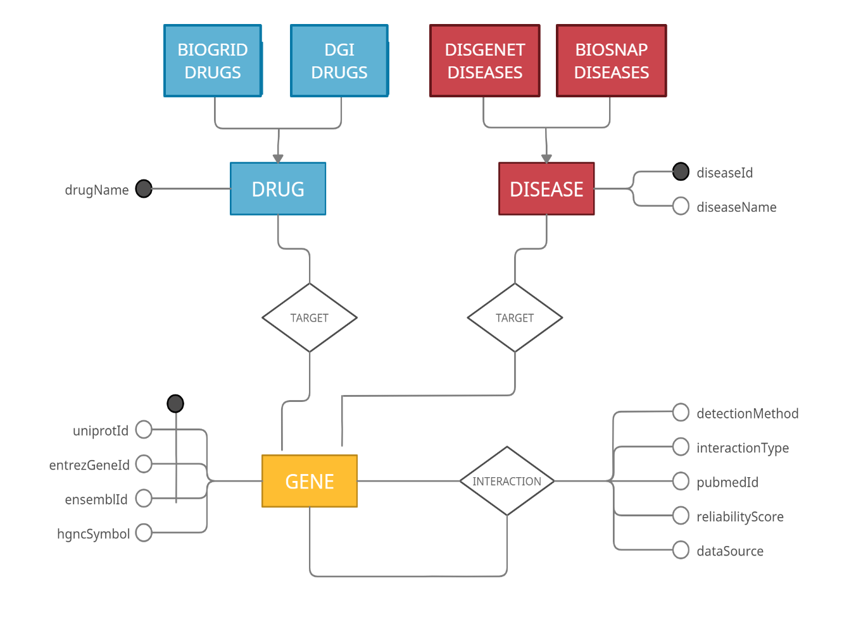
ER Schema
(0,n)
(0,n)
(1,n)
(1,n)
(1,n)
(1,6)

Slide 24
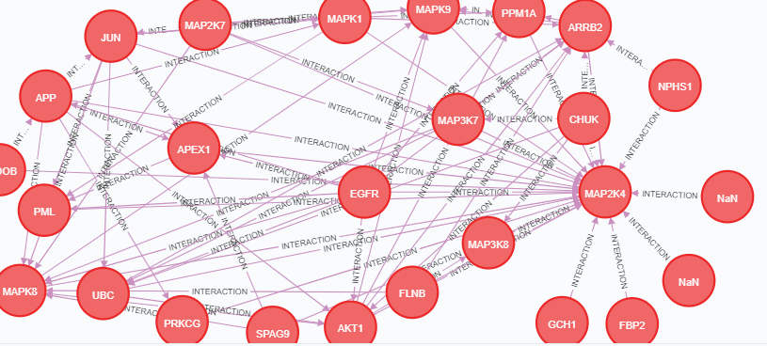
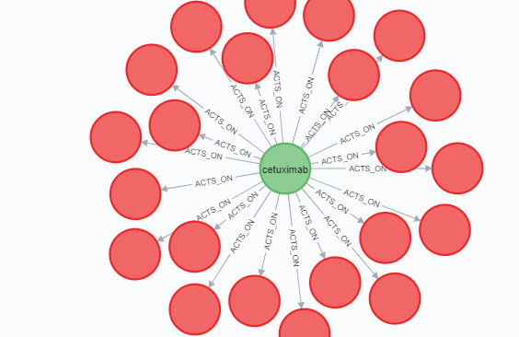
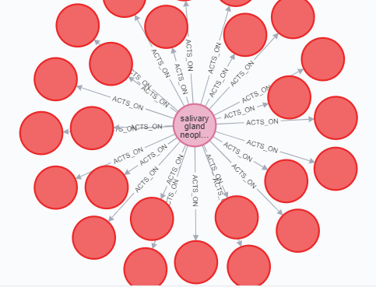
Store data in Neo4j
Through neo4j python module, we automatically store our formatted data in a Neo4j database (with APOC plugin):
Drugs
Diseases
Genes

Slide 25
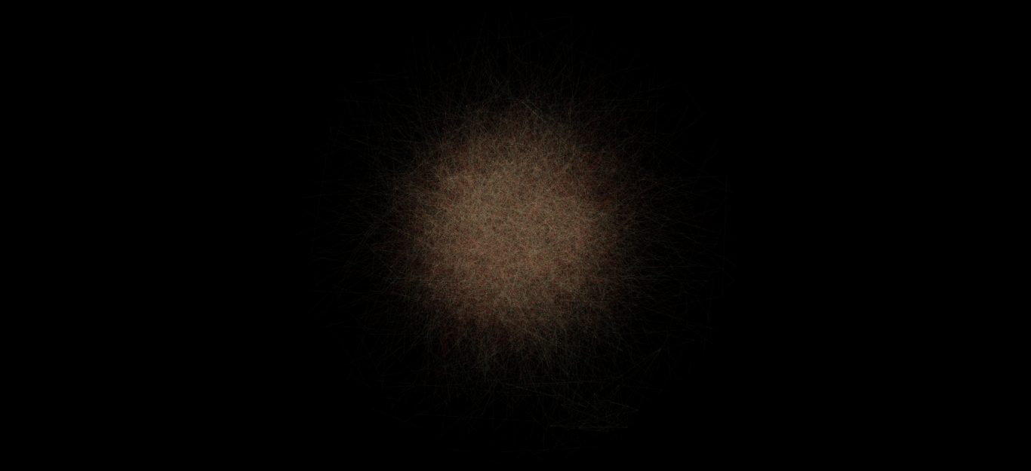

Slide 26
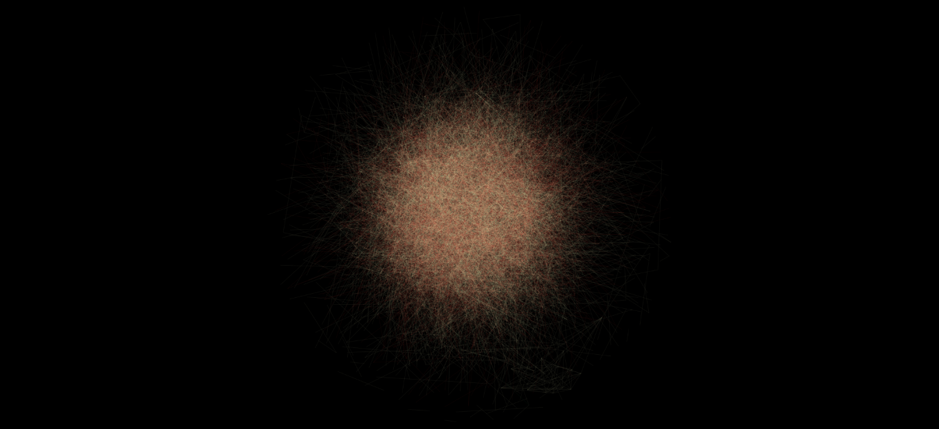

Slide 27
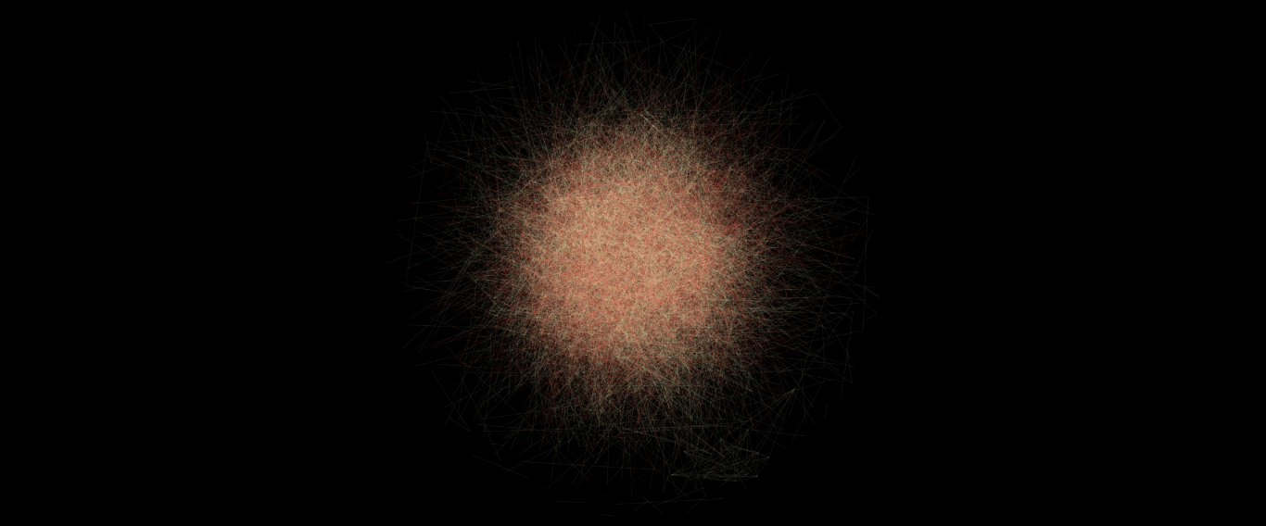

Slide 28
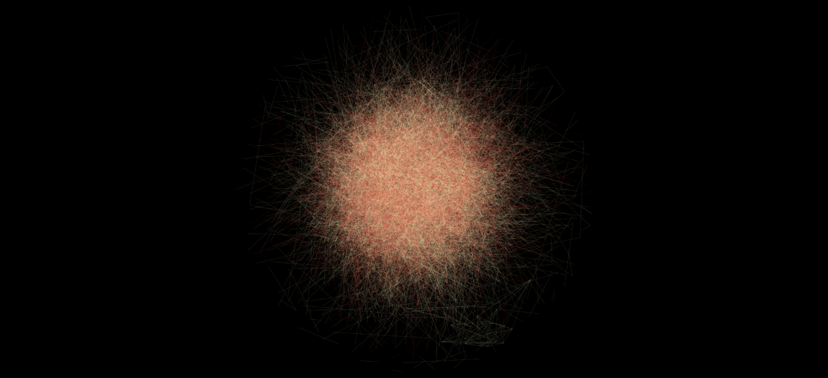

Slide 29
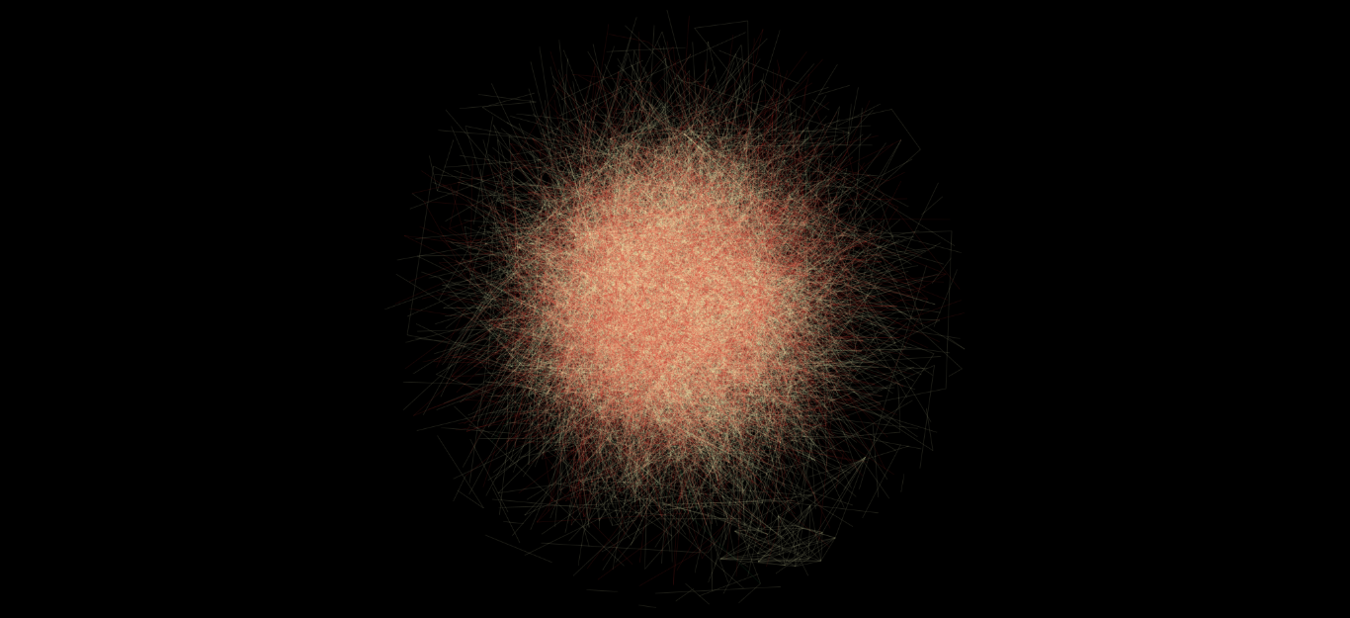

Slide 30
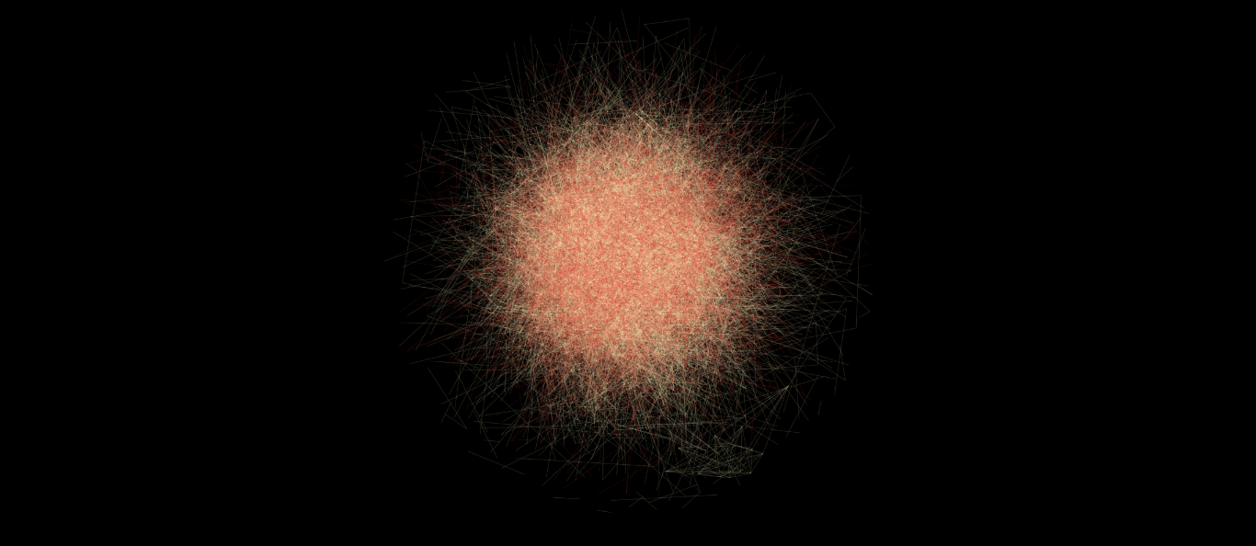

Slide 31
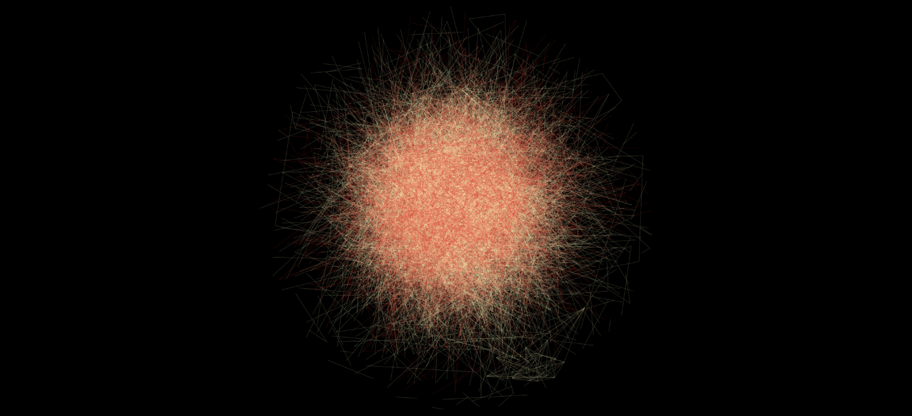

Slide 32
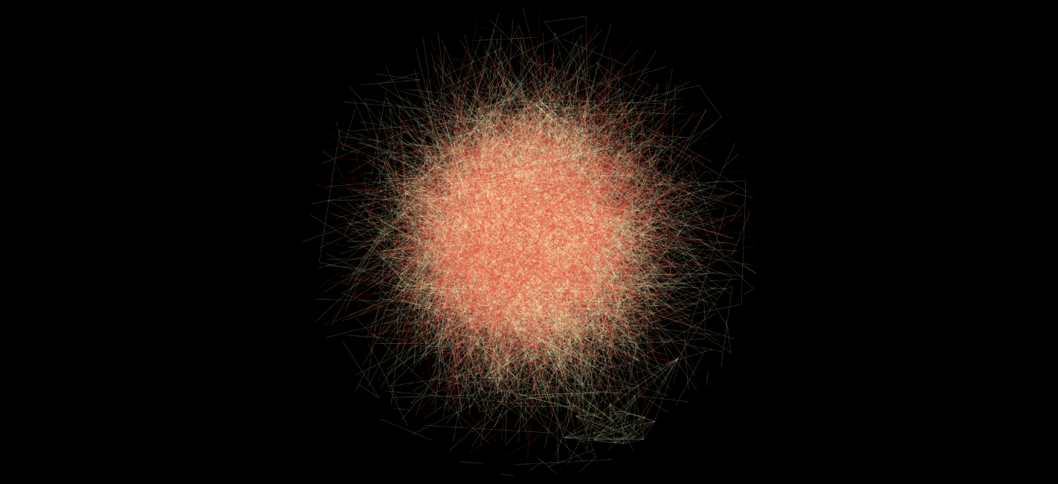

Slide 33
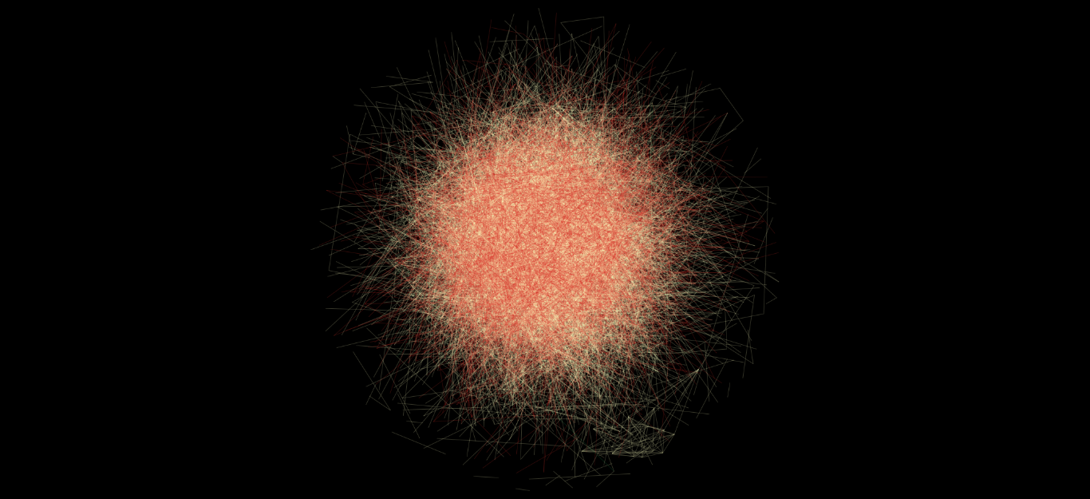

Slide 34
